Slide 1

Presentation of project 7
The brute-force analysis
Optimized solution though process and activity diagram
Optimized solution analysis
Optimized solution limitations
Dataset exploration

Slide 2
The brute force approach
Note: In our discussion below, space complexity refers to the additional space required by the function to return the output.
The idea behind our brute-force approach is straight-forward.
First, we compute the expected profit for each share.
The time complexity is O(N) : we loop through all the items doing one computation for each.
The space complexity is O(N/2) : the function takes two lists (the percentage from the shares yielded after two years
and the shares' price) and we need a third one of equal length to store the results.
Second, we computes all the possible combinations of items. If, e.g, there are six items, it will compute
all the combinations of one item, two items, three items and so on up to six. The time complexity of a nested
for loop is O(N**2). Although the use of a generator is efficient, it's space complexity is O(N).

Slide 3
Third, we need to compute the value and weight of each combination.
For each combination we need to do two computations inside a for loop. The time complexity is therefore O(N**2).
We use two variables to loop through the combinations but as the input grows, it becomes irrelevant.
Fourth, we use the built-in max function on the list of tuples containing the value and weight of each combination.
The time complexity is O(N) and the operation requires no additional space.
If we do the sum, it seems the time complexity is O(N) + O(N**2) + O(N**2) = O(2N**2 + N). That’s exponential time.
The space complexity is O(N/2) + O(N). That's linear space.

Slide 4
THE DYNAMIC PROGRAMMING APPROACH
The general idea behind any dynamic programming (DP) algorithm is to simplify a complicated problem by breaking it down into simpler sub-problem. We then use the solution to those subproblems to solve the problem.
In our case, given a maximum capacity max_c, we want to know the maximum value max_v we can get out of a set of n items.
The DP algorithm breaks down the set into n subsets. The first subset contains the first item, the second subset contains the first two items and so on up to the full set . Thus, the only difference between the i-th subset and the (i-1)-th subset is that the i-th subset contains the i-th item.

Slide 5
For each of these subsets the algorithm answers to max_c questions : if max_c was 1, what’s the max_v we could extract out of the subset ? if max_c was 2, what’s the max_v we could extract out of the subset ? And so on up to the actual max_c.
If we do the math, the number of questions the algorithm needs to answer for the full set is equal to max_c * n. If, e.g., there are 20 items and the max capacity is 10, 30 questions need to be answered.
This might seem as a lot of work. However, for the same number of items, the brute force approach needs to generate 1048575 combinations and evaluate the value of each of those combinations.
Furthermore, the brute force approach evaluate each combination independently while the DP solution answers to question in a more efficient manner. How ?

Slide 6
By leveraging the below two facts.
- If the weight of the i-th subset is greater than max_c , we can retrieve the answer from a previous question. Why ? Because if the i-th subset is heavier than max_c, it means the i-th item cannot be added to the bag. Thus, the value we can get out of the i-th subset is the same as the value we can get out of the (i-1)-th subset (remember the difference between two subsequent subsets is made by one item).
- if the i-th subset is as heavy or lighter than max_c, we have two options. We either take the i-th item or we do not take it.
If we take it (option 1), the value we can get is the sum of the value of the i-th item and the value we can extract out of the subset (i-1) if capacity was max_c - weight of the i-th item.
If we leave the item out of the bag (option 2), the value we can get out of it is the value we can get out of the previous subset given the same capacity.
By leveraging those two facts, the algorithm avoids unnecessary computations and instead retrieves values whenever possible.

Slide 7
The last answer given by the algorithm is also the solution to the problem. How come ? Because the last subset is identical to the full set.
At this point, we know the maximum value we can extract out of the set of items. However, we do not know the items we need to choose to attain that value. In order to discover the items we need in our bag, we go through our previous answers in reverse order. That’s called backtracking.
For implementing the DP algorithm we create an empty table. There are max_c rows and n columns. Then, we complete the table sequentially, one row after the other.
Completing the case at row 3, column 4 amounts to answering the question “If max capacity was 3, what's the maximum value we can extract out of the subset containing the first 4 items of the set ?"

Slide 8
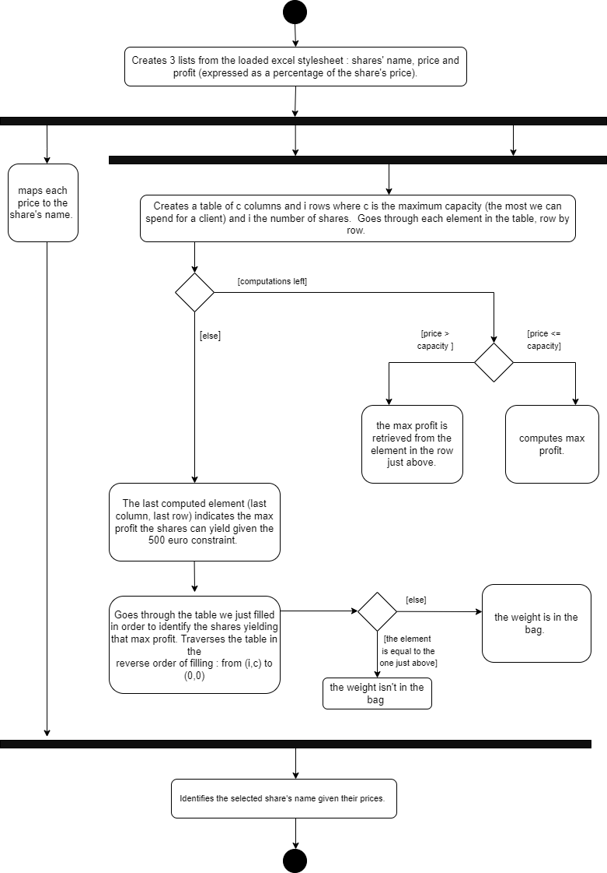
THE DIAGRAM

Slide 9
TIME AND SPACE COMPLEXITY ANALYSIS
Now, let's analyze the algorithm's complexity. Before coming to the solution on it's own, we need to prepare the data. Five operations are needed.
The first is reading the excel stylesheet containing the shares: time complexity O(N) and no additional variable is needed.
The second is going through the data and creating three lists: time complexity O(N) and three additional variables are needed O(3N).
The third is creating a dictionary mapping the share's weight to it's name: time complexity O(N) and one additional variable is needed O(N).
The fourth is cleaning the three lists. We need to loop through each of them. time complexity O(N) and no additional variable is needed.
The fifth is computing the profits in absolute value from the percentages of the shares: time complexity O(N) and space complexity is O(N/2).
If we do the sum, time complexity is O(4N) which is linear time. The space complexity is O(4N + N/2) which is also linear.

Slide 10
After those five operations, the data is ready. The DP function takes three args. Two lists of equal length n (weights and values) and an integer max_c. The time and space complexity of the DP algorithm depend on the size of the lists and on how big max_c is.
The first operation is building an empty table. We use a nested loop that creates n lists of size max_c. The time and space complexity are thus O(n*max_c).
The second operation is going through the table. We use a nested loop but we do not need additional variables. The time complexity is again O(n*max_c).
The third operation is the backtracking. We need a nested loop and a list holding a reference to the chosen items. The time complexity is thus O(n*max_c) while the space complexity is O(n).
If we do the sum, time complexity is O(3n*max_c) which is polynomial time. The space complexity is O(n*max_c + n) which is also polynomial.

Slide 11
Before returning the result we do some formatting which involves going through the map created before the execution of the DP function.
In the big picture, this won't change the algorithm’s complexity. Thus, if we sum up the complexity of what happens before the DP function with what happens in it, we get the following : time complexity is polynomial (as the input scales up, the linear becomes irrelevant). The same goes for space complexity.
This is much better than the brute force approach’s exponential complexity. The difference is sensible even when there are only 20 items to choose from. The brute force algorithm takes approx. 1.3 sec while the DP algorithm needs 0.003 sec. The outputs are the same.

Slide 12
The dp approach limitations
There seems to be two main limitations of the dynamic programming solution.
First, it needs to convert the weights to integers. For navigating through the table of subproblems, the weights are used to compute indexes. We are forced to convert using math.ceil() to make sure we respect the capacity constraint. The conversion’s side effect is that the result of the algorithm isn't the absolute best. E.g., for the first dataset, instead of choosing the share DBUJ(w=0.07, v=10.73) we could've chosen IYKD(w=1.08, v=13.02).
A second limitation is that the capacity constraint (max_c) cannot be too big, even if the number of items stays low. The problem is that we need to create max_c columns. Which is odd because if we have 4 items and the max capacity is 10**10, our algorithm would crash although we could solve the problem with a pen and paper.

Slide 13
DATASET EXPLORATION
Unfortunately, we lack two interesting pieces of information. The first is the algorithm that Sienna chose. The second is the time it took the algorithm to compute the results. All we have is the shares her algorithm chose.
For the first dataset, our algorithm choose the shares GRUT(w=498.76, v=38.42) and DBUJ (w=0.07, v=10.73) for a total value of 196.84 euros and a weight of 498.83 euros. Sienna only chose GRUT. Thus, our solution is only 13 cents better.

Slide 14
For the second dataset, our algorithm chose ECAQ(31.66, 39.49), FWBE(18.31, 39.82), ZOFA(25.32, 39.78), PLLK(19.94, 39.91), OPBR(39.0, 38.95), AIEB(27.14, 7.6), ZOEN(33.47, 2.42), JSMQ(29.86, 7.55), JWGF(48.69, 39.93), USJZ(35.49, 34.37), ZKSM(32.55, 23.24), YEIX(22.78, 3.11), OUKR(40.23, 8.29), SMHV(14.66, 12.77), JSMQ(29.86, 7.55), QTFR(5.91, 3.23) for a total weight of 493.87 euros and a total value of 194.91 euros.
Sienna chose ECAQ(31.66, 39.49), IXCI(26.32, ), FWBE(18.31, 39.82), ZOFA(25.32, 39.78), PLLK(19.94, 39.91), YFVZ(22.55, 39.1), ANFX(38.55,39.72), PATS(27.70, 39.97), NDKR(33.06, 39.91), ALIY(29.08, 39.93), JWGF(48.69, 39.93), JGTW(35.29, 39.43), FAPS(32.57, 39.54), VCAX(27.42, 38.99), LFXB(14.83, 39.79), DWSK(29.49, 39.35), XQII(13.42, 39.51), ROOM(15.06, 39.23) for a total weight of 489.24 euros and a total value of 193.78 euros.
Thus, our solution is 63 cents better.

Slide 15
Now, on the second dataset where the choice are more different, we could make the following comparison. Whose choice present the better ratio of return on investment ? For every euro invested, Sienna’s algorithm returns after two years 0, 396 euros. Ours is a bit less efficient : It returns 0, 394 euros.
However, because we only have two datasets, we cannot be sure the observed trends would hold on other datasets.

